Slide 1
Medium-Fi Prototyping
Kendall Costello, Tina Jiang, Andrea Shulman, Steve Weyns
Notes:
Our presentation focuses on the work we have done this past week in terms of creating our medium fidelity prototype. Please enjoy :)

Slide 2
Value Prop, Problem, and Solution

Slide 3
“reflection made simple”
Problem
Users are unable to cement memories in a consistent and frictionless manner because they do not prioritize reflection. Existing solutions unintuitively incorporate multimedia, and result in unorganized collections of random experiences.
Solution
A blank slate that allows users to record, edit, and organize their memories using minimalist design and added keyboard capabilities.
Notes:
We stumbled upon the issue that while several other apps exist that embody some form of multimodality, these solutions were often extremely unintuitive. By unintuitive, we mean that these apps provided some sort of limited functionality that felt awkward to use for the purposes of journaling/reflecting. Furthermore, most apps, such as iNotes, result in unorganized collections of random experiences, which was also a problem.
As such, our value proposition is to make reflection simple. We want to provide users with a blank slate that allows them to record, edit, and organize their memories using minimalist design and added keyboard capabilities.

Slide 4
Tasks

Slide 5
Simple Task
Creating mementos on the fly
Notes:
The crux of our product, to create momentos at the time of/day of

Slide 6
Moderate Task
Reflecting about specific memories
Notes:
By reflection, we are focused on the editing of memories.

Slide 7
Complex Task
Mapping mementos by creating relational associations
Notes:
By mapping mementos via relational associations, we are talking mainly about the organizational aspect of our prototype, which is portrayed as our collection.

Slide 8
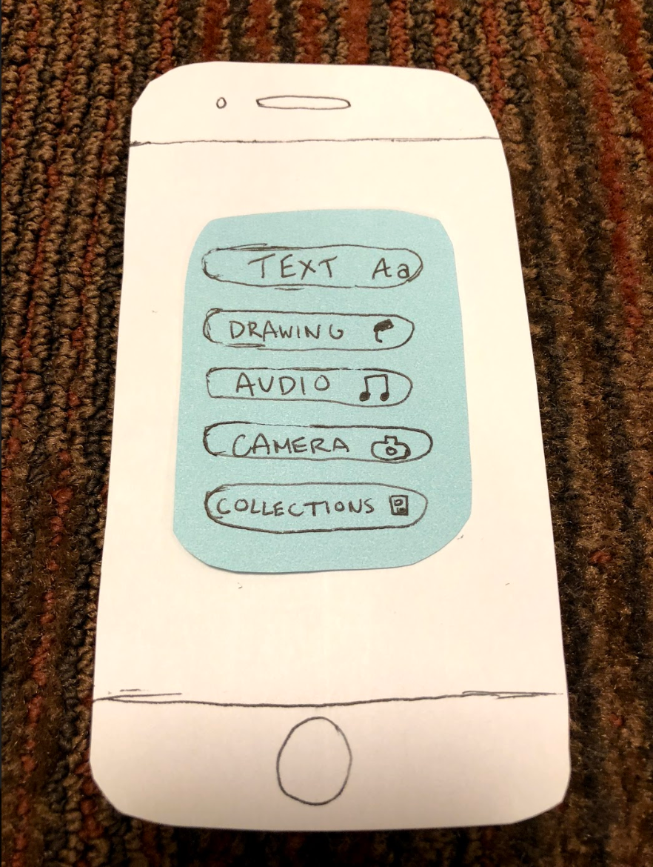
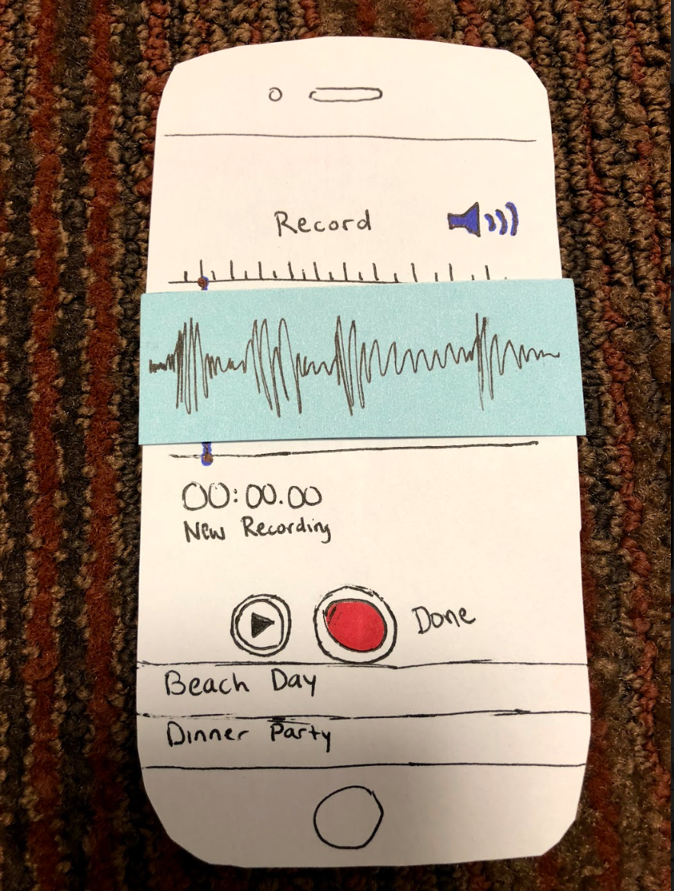
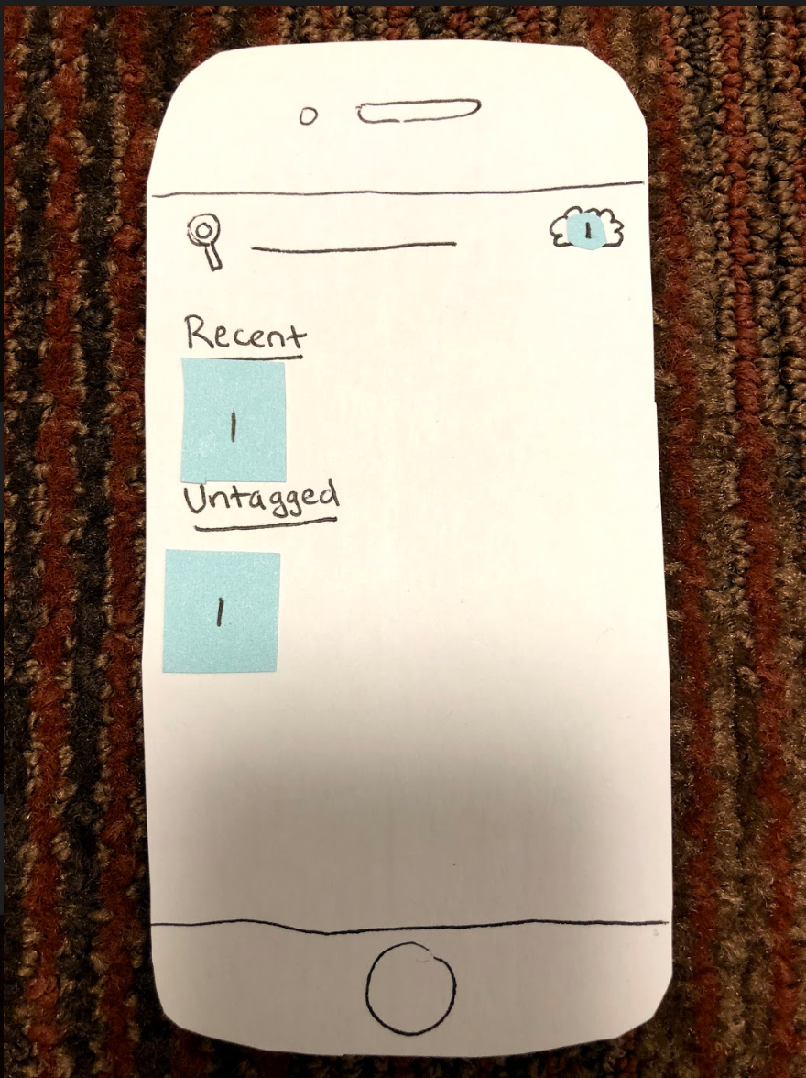
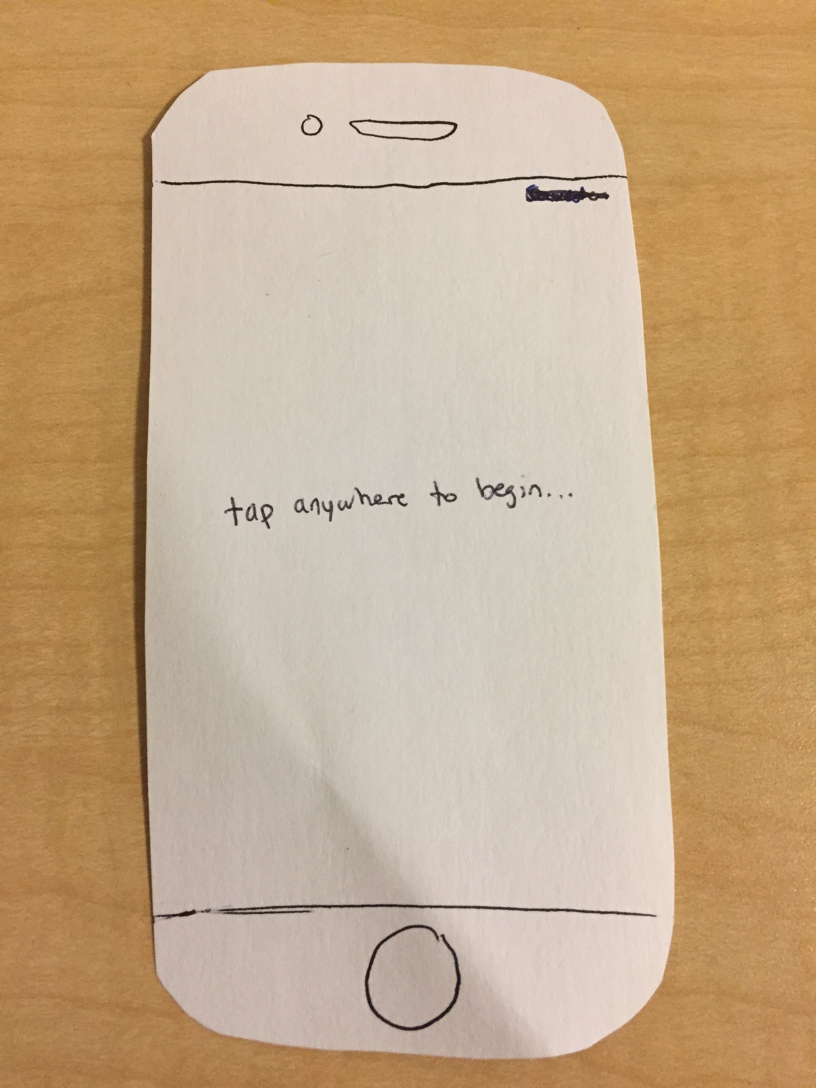
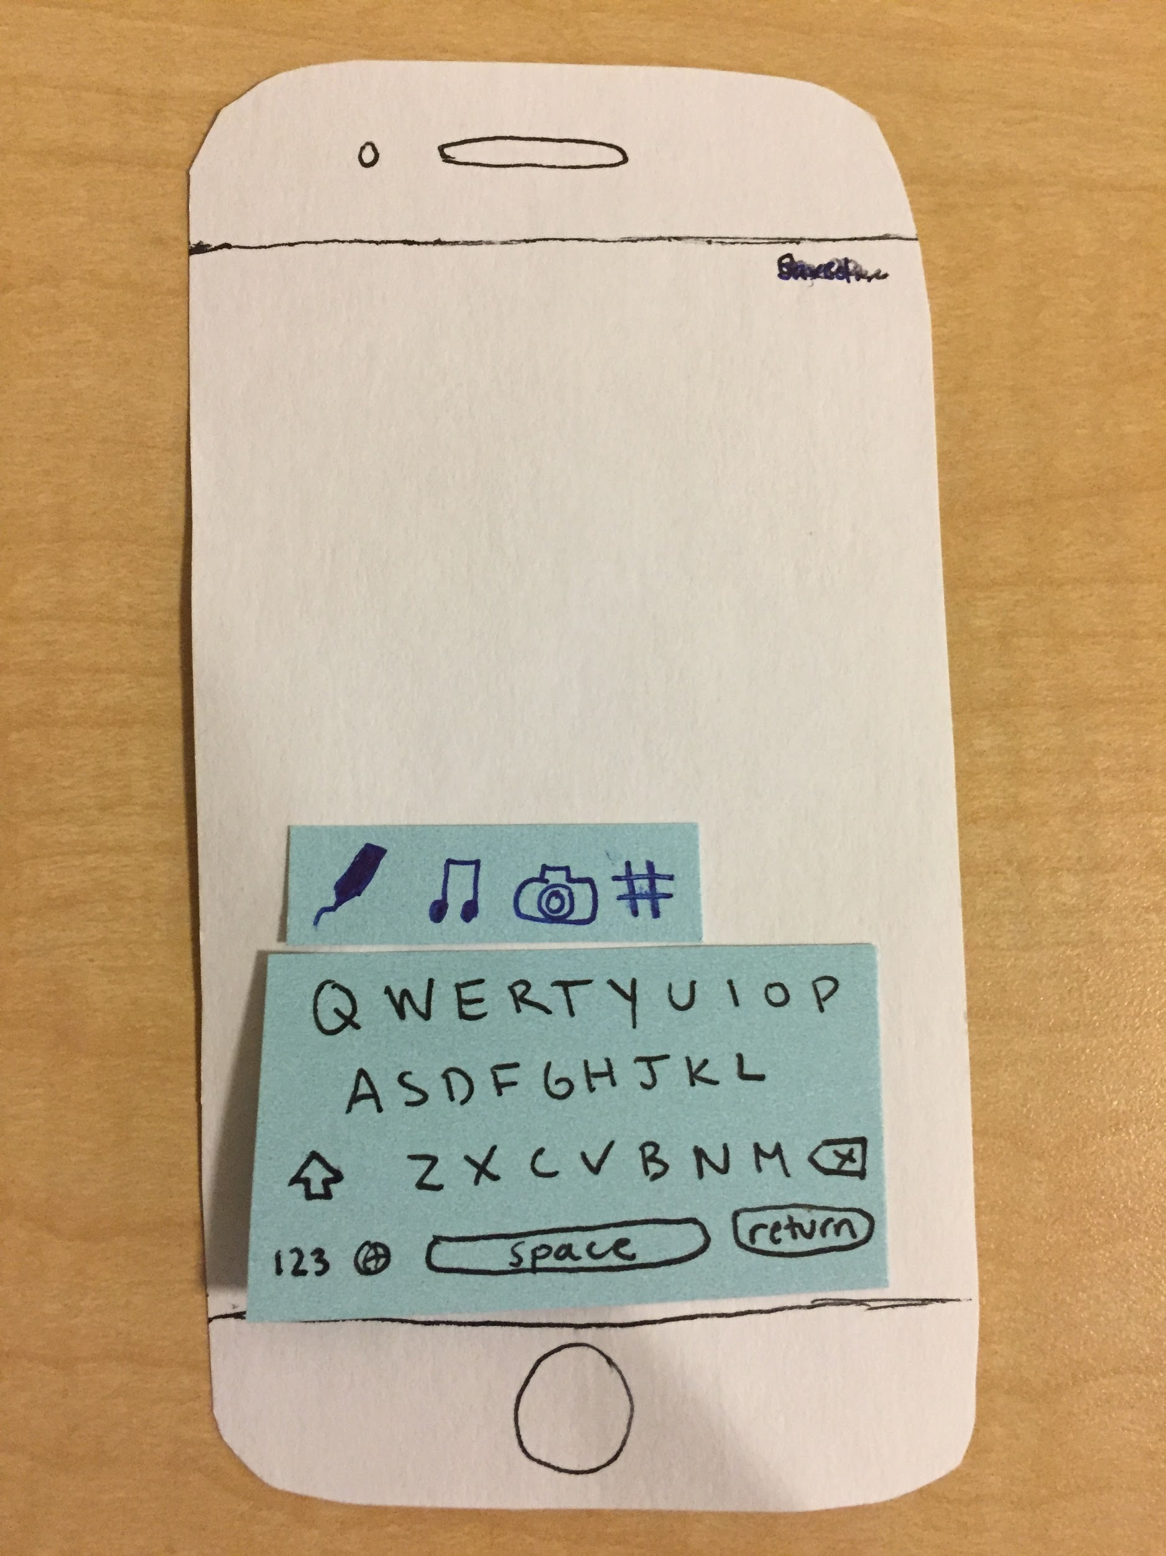
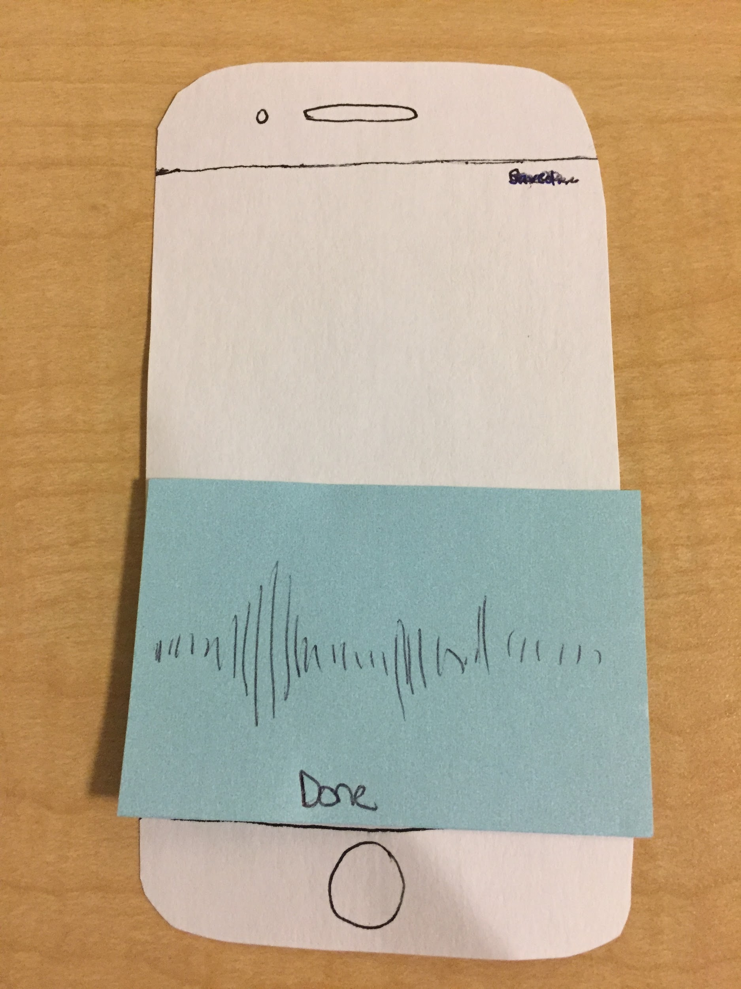
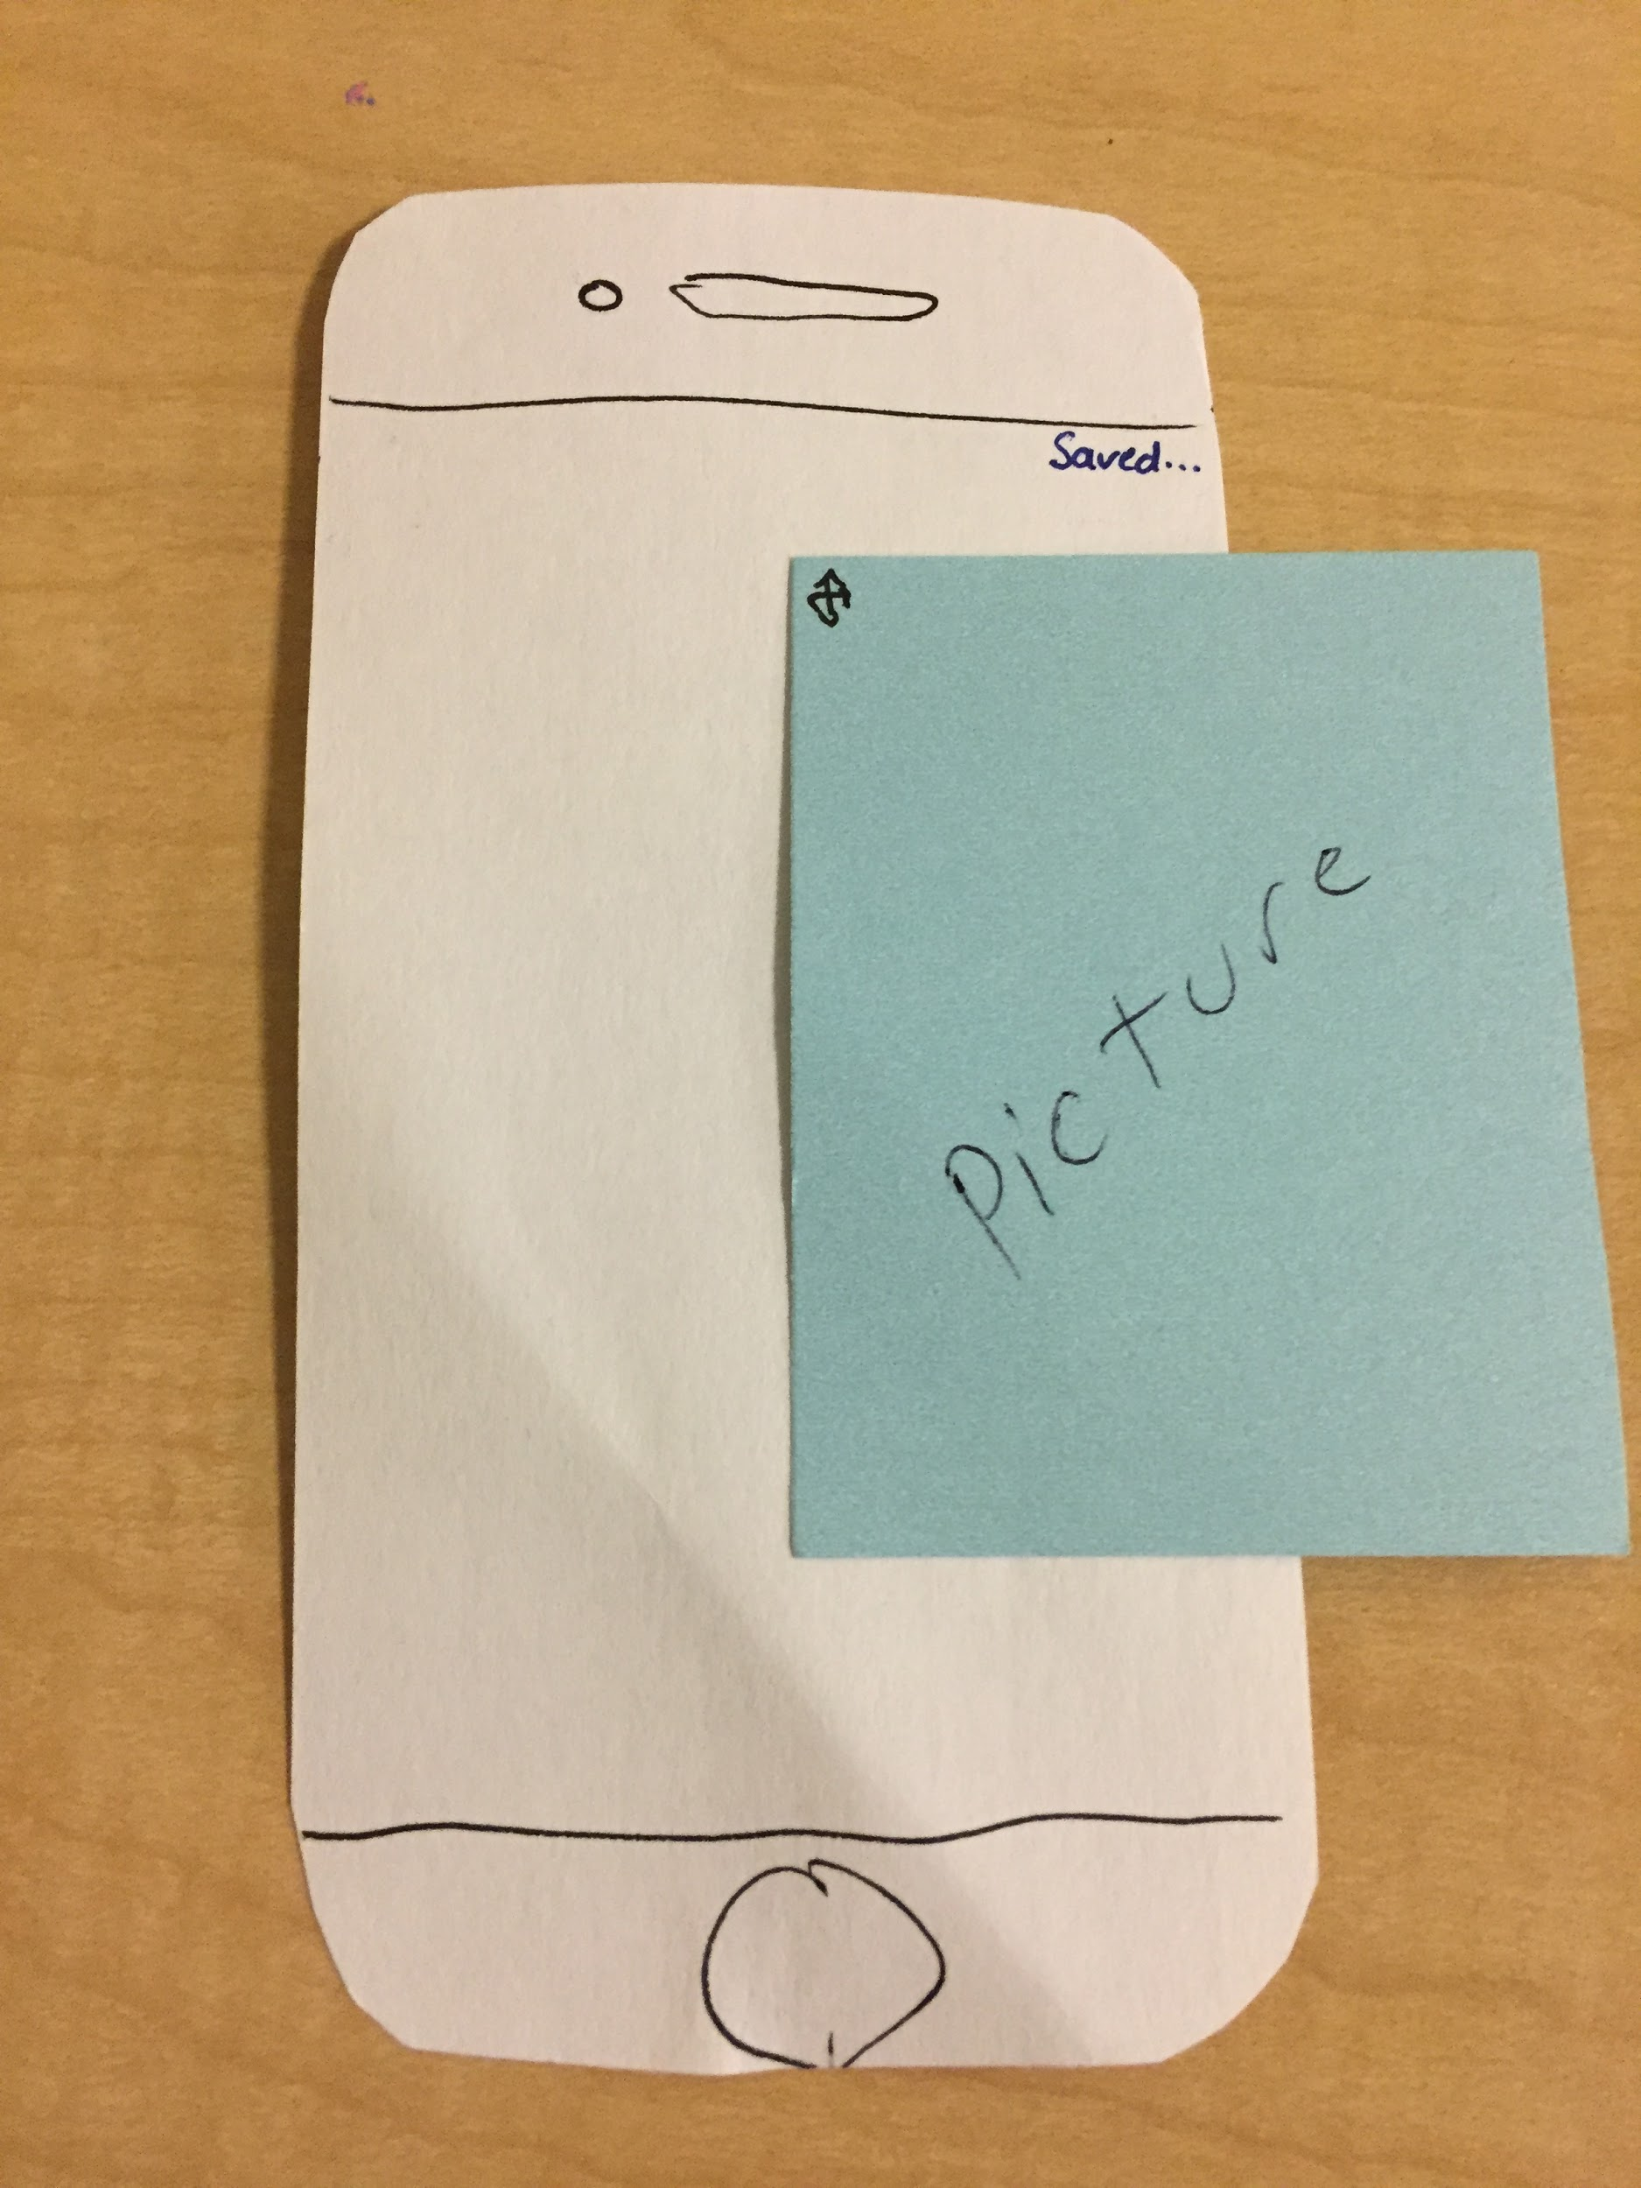
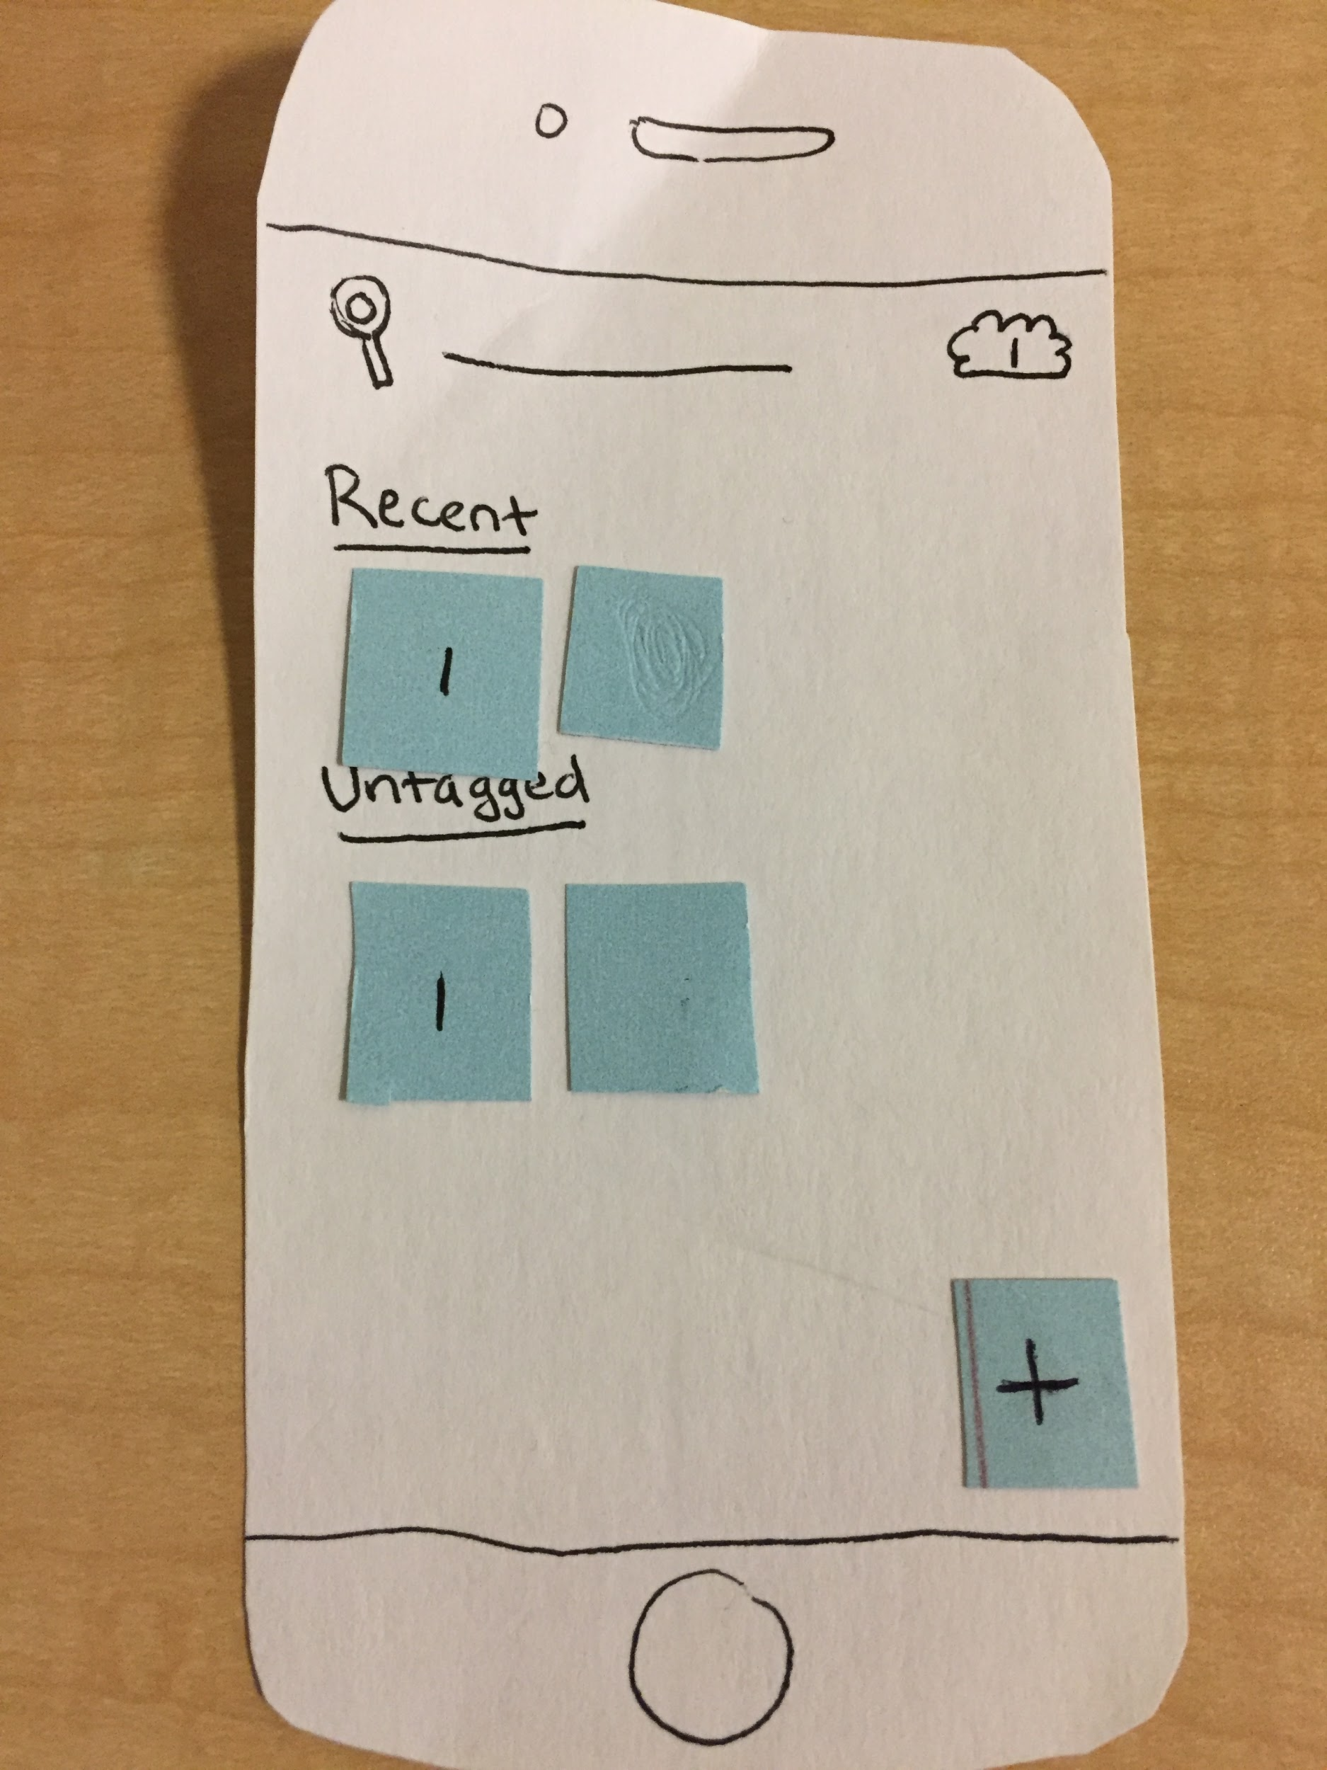
Old
Revised
Notes:
New stuff:
Tap anywhere to begin start screen
Not as overwhelming thanks to small amount of guidance
Everything is now in the keyboard
Gets rid of unintuitive gestures mechanism, also makes the entire experience just one click rather than going through a menu
Audio in app
Took too long to come in and out of voice memos. That was also unnecessary as people would not usually add prerecorded memos.
Saved… in corner
Gives users feedback so they are not wondering how to save their work
Media added to the side so user knows to scroll
It was unclear that the space is infinite. This allows users to see that there is more to the blank slate than what they see at first.
Also added resize button on media
Allows users to resize so they can organize more easily

Slide 9
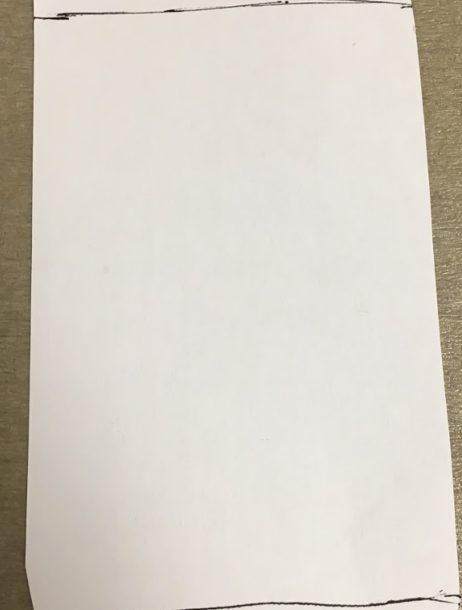
Old
Revised
Added message makes experience less overwhelming thanks to small amount of guidance

Slide 10
Old
Revised
Putting everything in the keyboard gets rid of unintuitive gestures mechanism, making the entire experience just one click rather than going through a menu

Slide 11
Old
Revised
It took too long to load Voice Memos app, and it was also unnecessary as people would not usually add pre-recorded memos. We moved it in app.

Slide 12
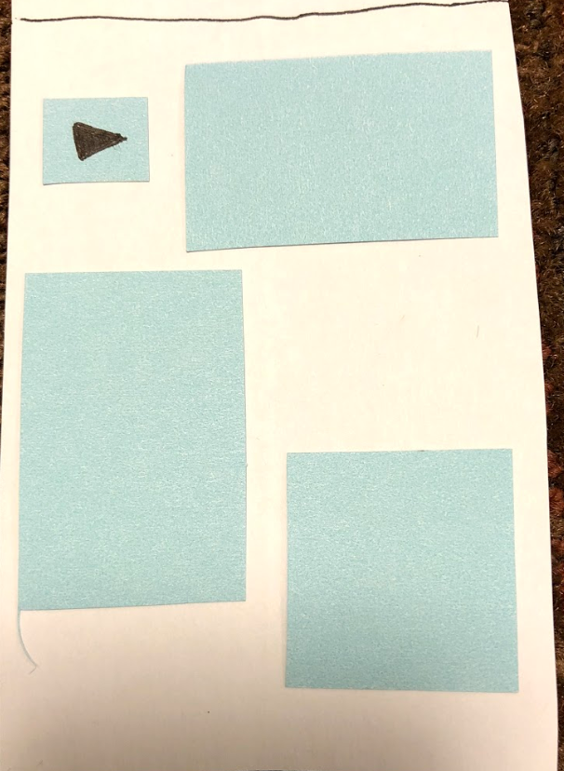
Old
Revised
It was unclear that the space is infinite. Adding media partially offscreen allows users to see that there is infinite space
Adding “Saved…” gives users feedback so they are not wondering how to save their work
We now allow users to resize so they can organize more easily

Slide 13
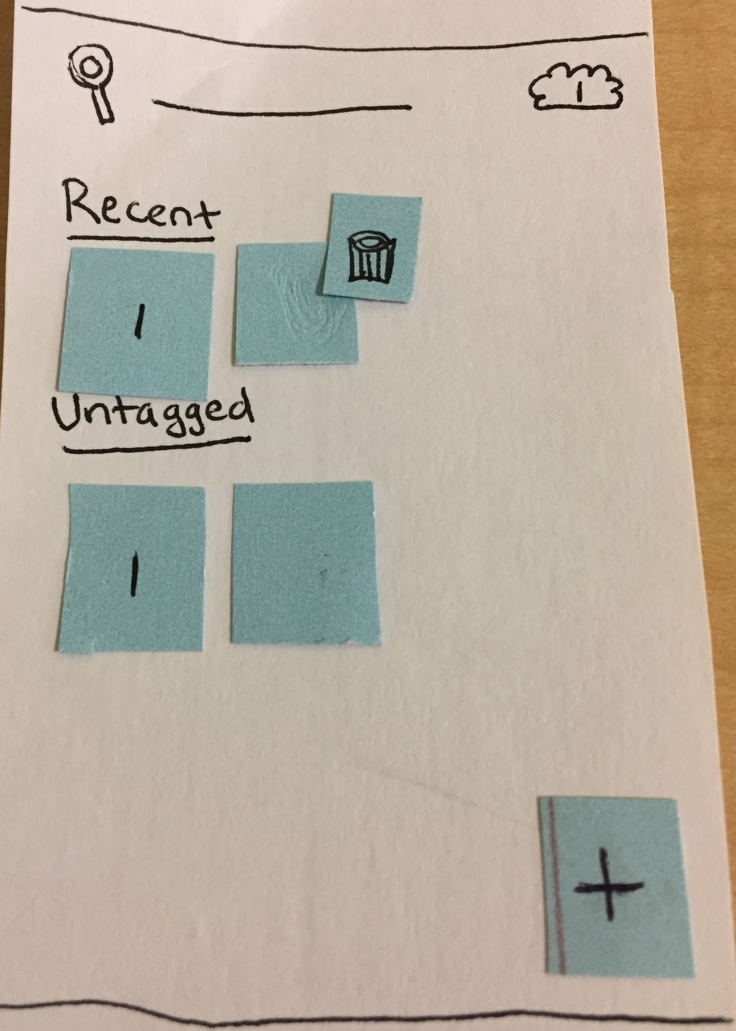
Old
Revised
Trash capability was not available for full memories before, so adding it further enhances the memory editing process

Slide 14
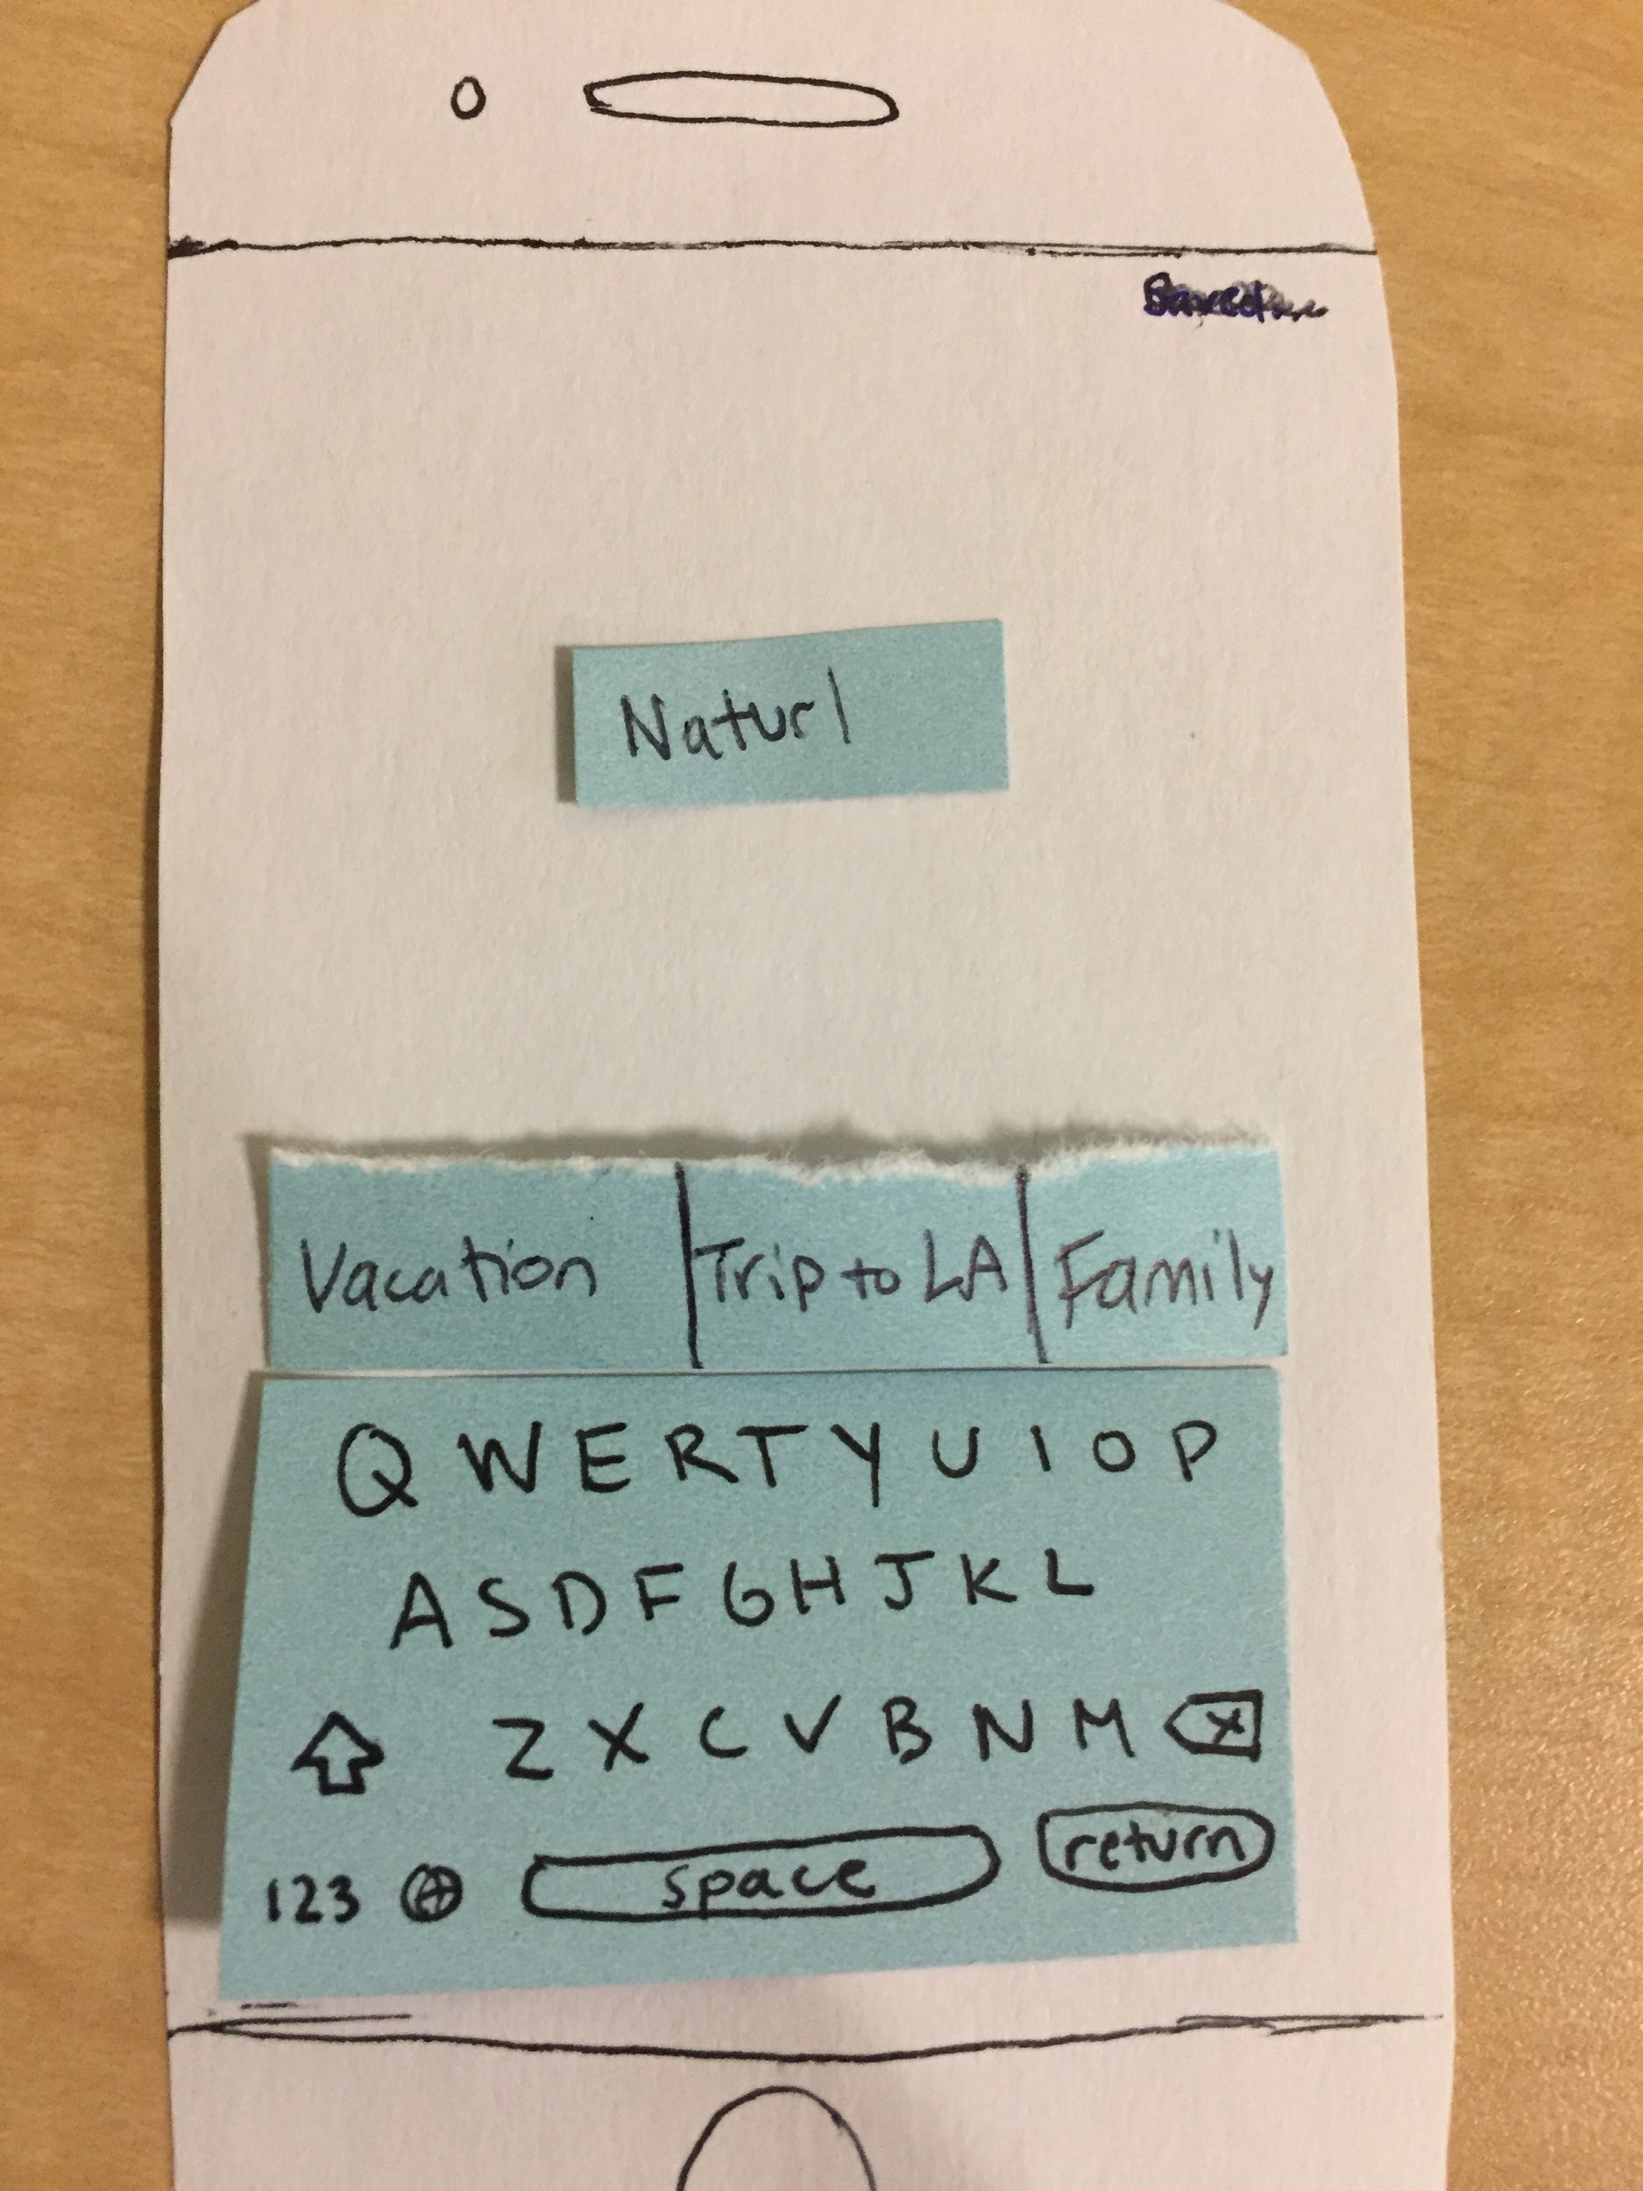
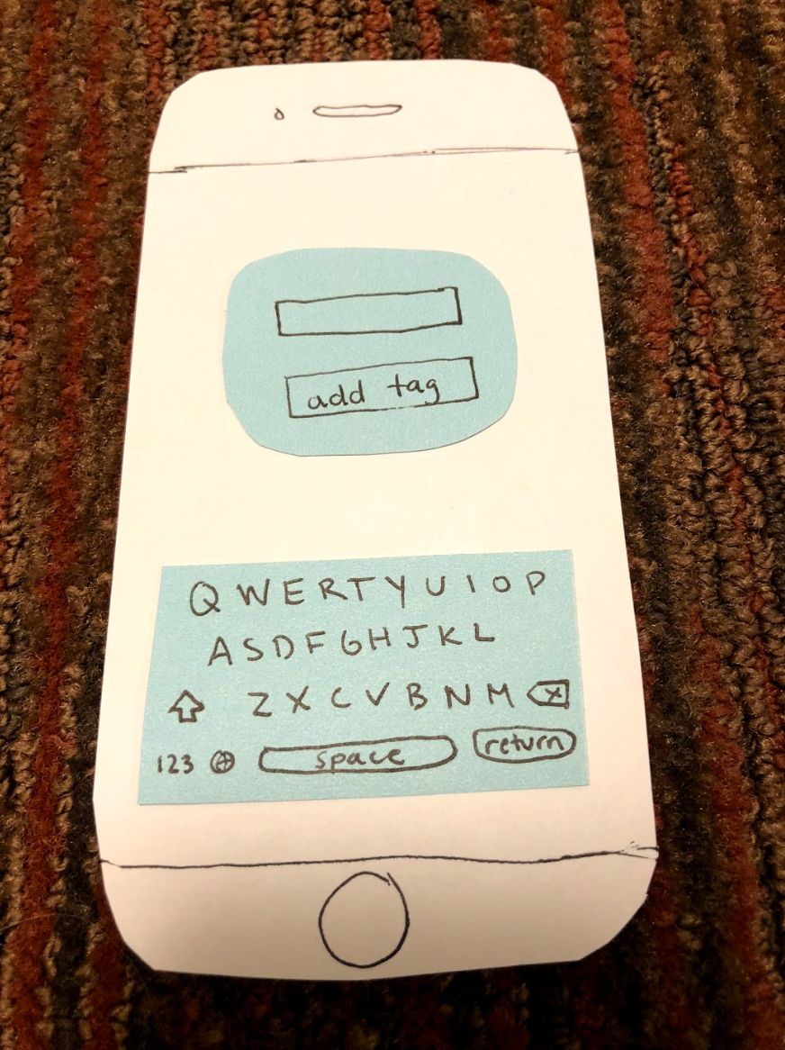
Old
Revised
Adding suggestions to tagging implements reminders over recall so people do not have to remember what some of their albums are called

Slide 15
Revised Interface Design

Slide 16
Task Flows

Slide 17
Simple Task Flow

Slide 18



Notes:
Tap anywhere on the screen to begin and type. What you type is automatically saved.

Slide 19
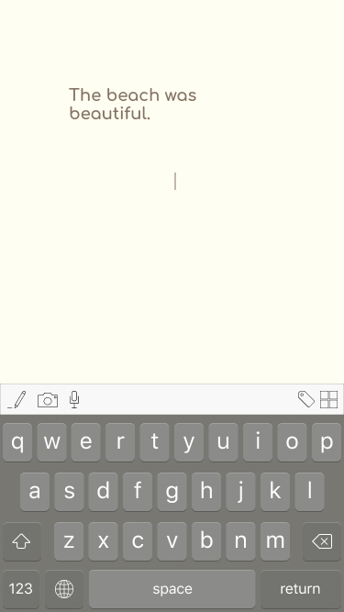
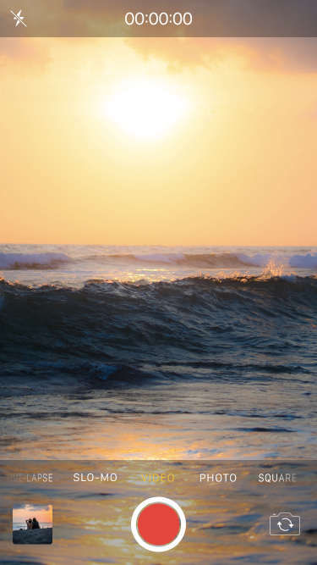

Notes:
Tap on the camera icon on the keyboard to go to the camera. Once you snap the photo it will exit camera mode and take you back to the slate with the photo on it

Slide 20
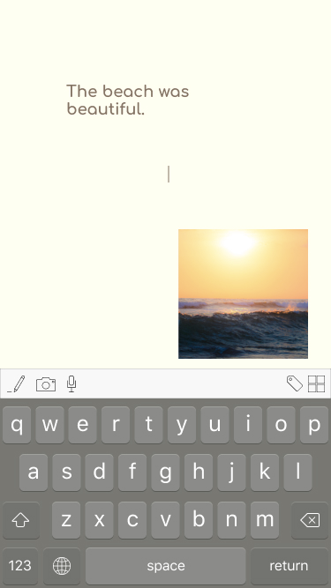
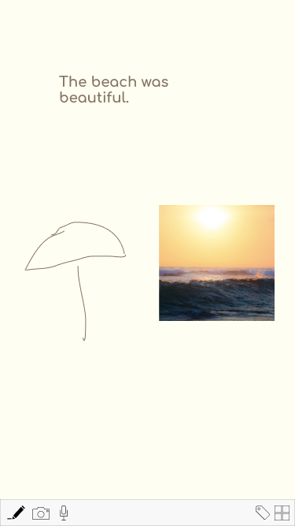
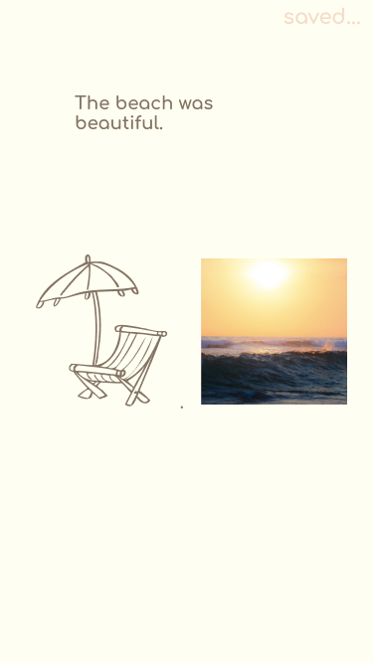
Notes:
Tap the pencil to draw anywhere on the slate. You can exit draw mode by tapping the pencil again.

Slide 21
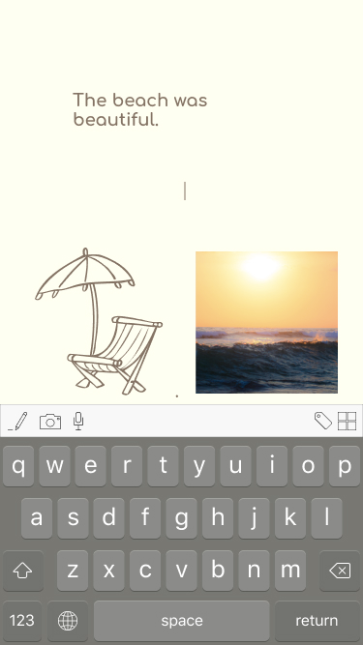
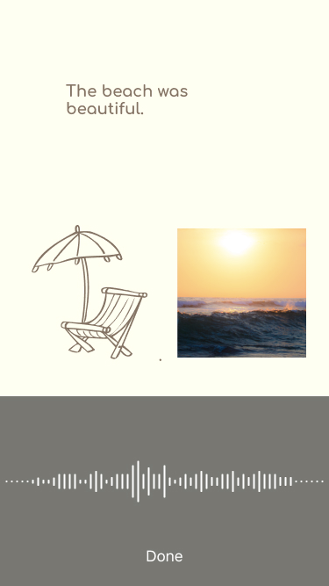
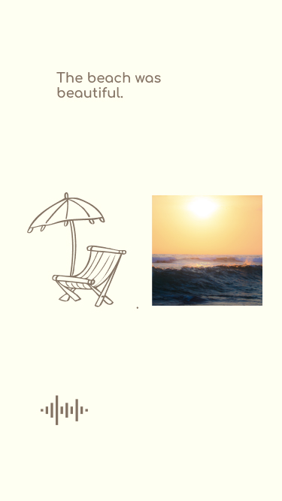
Notes:
Tap the audio icon to enter recording mode where it automatically starts recording. Click Done when you’re finished and you’ll be taken back to the slate with the audio now showing up as a icon that you can click to here the audio play.

Slide 22

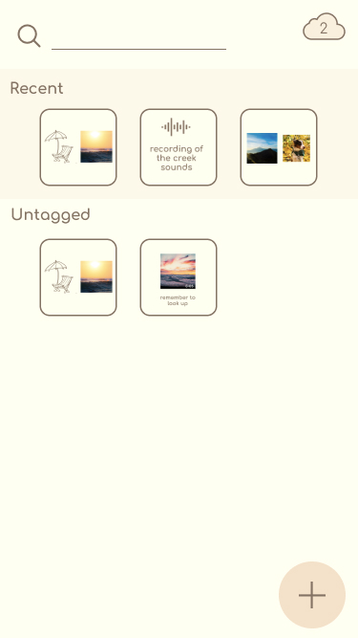
Notes:
Tap the collections icon on the keyboard to be taken to collections. You can see the slate you just created pop up under recent. It also shows up under untagged since you haven’t tagged it yet.

Slide 23
Moderate Task Flow
Notes:
As for our mission statement, we want to

Slide 24


Notes:
Hold your finger on the drawing to have the trash and resize icons show up. If you click the trash icon the drawing will be deleted

Slide 25
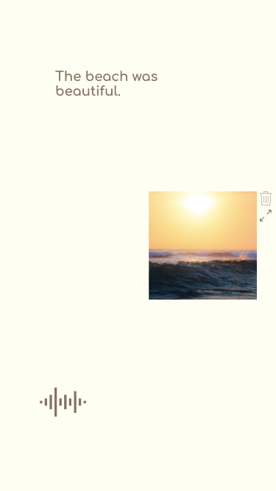
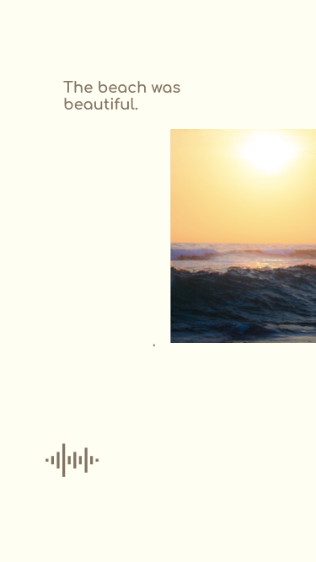

Zoom out by using fingers in the “zoom out” motion
Notes:
If you click the resize icon you can pinch to resize the photo. You can also zoom out of the slate by pinching.

Slide 26
Complex Task Flow
Notes:
As for our mission statement, we want to

Slide 27
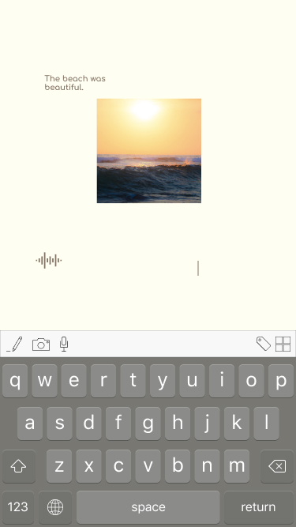
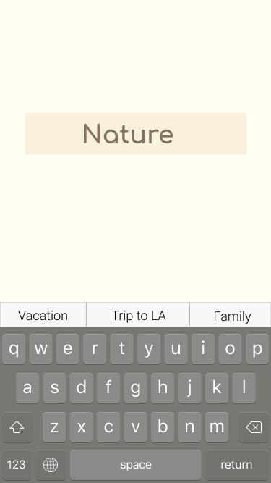
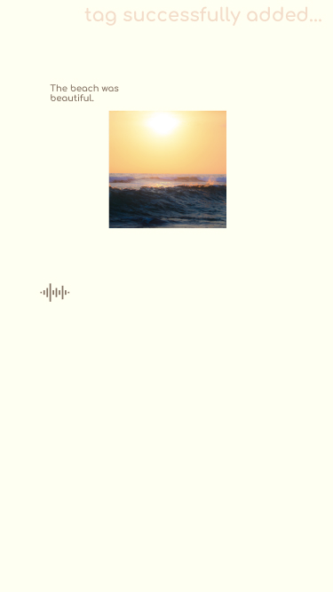
Notes:
Click the tag icon on the keyboard. You can type what you want to tag the photo or you can choose from some options on the top of the keyboard. The options come from what you may have previously tagged other slates. When you’re done tagging, you’ll get feedback saying it was successfully added.

Slide 28
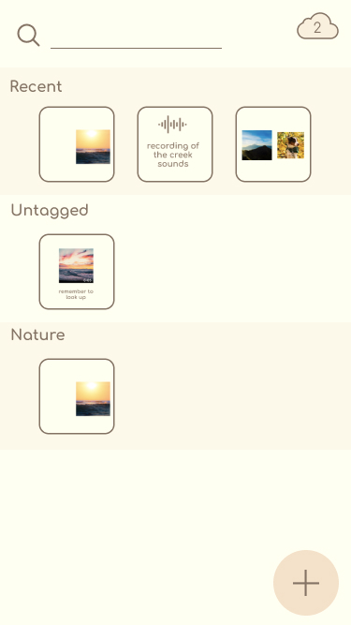
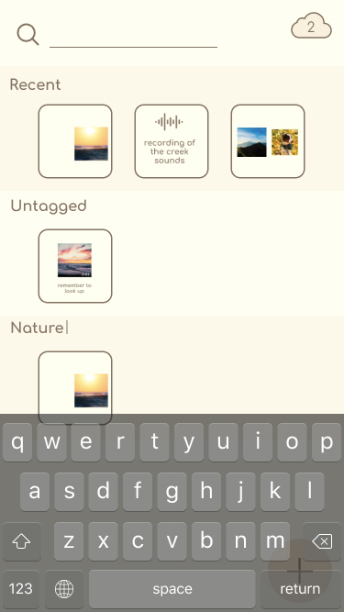

Notes:
If you click on the nature category, you can change the tag and edit the name.

Slide 29
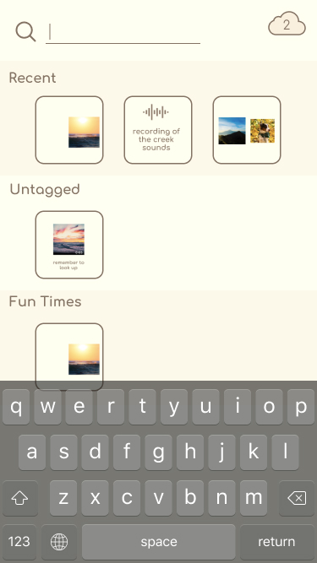
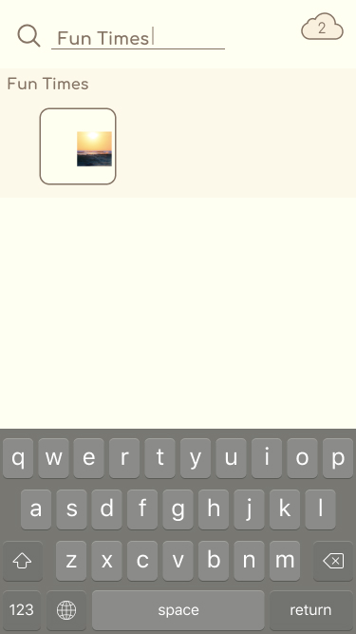

Notes:
If you search for a tag on the search bar, the slates will come up

Slide 30
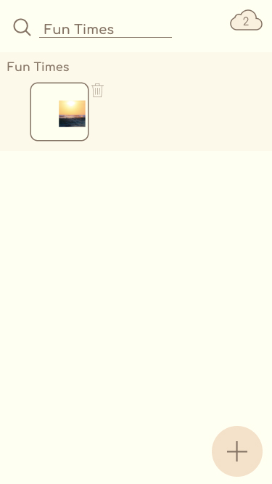
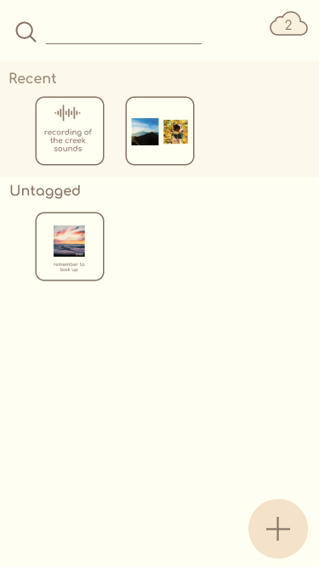
Notes:
If you hold on the thumbnail of the slate the trash icon will appear and you can tap on that to delete the entire slate

Slide 31
Prototype Overview
Notes:
As for our mission statement, we want to

Slide 32
We Used:
Figma
Invision
How the Tools Helped:
Figma allowed us to all collaborate online
Figma helped create visuals
Invision helped make the prototype interactive
How the Tools Didn’t Help:
Couldn’t create all the features
Couldn’t actually store user input
Limited interaction (e.g can’t scroll, can’t zoom in/out)

Slide 33
Limitations/Tradeoffs
Could not add personalized media
User data is not stored as we did not have a database
Did not have extensive workflow because there are too many permutations
Ability to toggle calendar view
Double tap instead of hold for deletion and resize due to InVision
Double tap to zoom and move around the screen due to InVision
Notes:
Why:

Slide 34
Wizard-of-Oz Techniques and Hardcoded Features
All media users can add is premade
The camera and camera roll are pre-populated
Tags and organization
Resize capabilities
Search bar

